Slide 1
Intro To Programming JavaScript

Slide 2
Brief Summary Of Chapter 1
What is JavaScript
JavaScript Syntax
Writing Some JavaScript
Chapter 1: What is JavaScript?

Slide 3
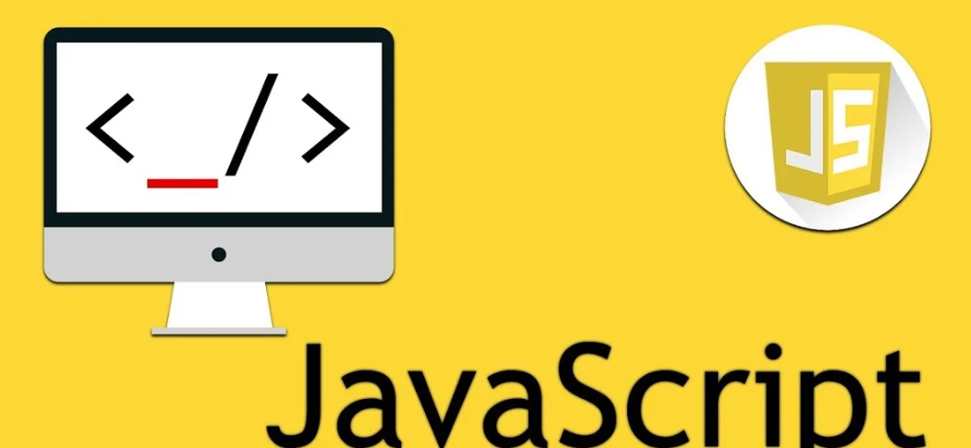
JavaScript is a programming language that makes websites do cool stuff like changing button colors, animating, checking forms, and making games.
Your web browser runs JavaScript, which helps websites become more interactive and useful. https://www.patatap.com/
What is JavaScript?

Slide 4
JavaScript has its own rules on how to write code, in other words it tells you how to write your code correctly so that computers can understand and execute it properly.
Parentheses ():
Used to group expressions and arguments. For example, they are used in function calls and control structures like if statements.
Semicolons (;):
Used to terminate statements. They indicate the end of a line of code and separate multiple statements on a single line.
Curly Brackets {}:
Used to define code blocks. They group multiple statements together, such as the body of functions, loops, and conditional statements.
Plus Signs +:
Used for addition and string concatenation. In math expressions, it adds numbers, and in strings, it joins them together.
var:
Used to declare a variable
console.log:
A function used to print output to the console.
JavaScript Syntax

Slide 5
Naming a Variable:
Variable names must begin with a letter (a-z, A-Z), an underscore, or a dollar sign ($).
Variable names cannot contain spaces.
Variable names are case-sensitive
Avoid using reserved keywords (e.g., if, for, while) as variable names.
Incrementing:
Pre-increment (++x): Increases the value of x by 1 before using it.
Post-increment (x++): Uses the current value of x and then adds 1.
Decrementing:
Pre-decrement (--x): Decreases the value of x by 1 before using it.
Post-decrement (x--): Uses the current value of x first, then decreases it by 1.
Comments:
Comments help explain code for better understanding.
// I am writing my first comment.

Slide 6
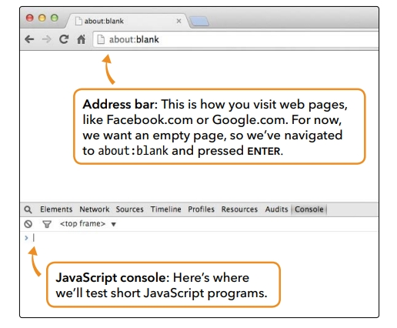
You can start learning JavaScript right in your Google Chrome browser. First, go to a blank page by typing about:blank. Then right-click anywhere on the page and select Inspect, then click the Console tab. The console lets you write and test small bits of JavaScript code immediately. Chrome also highlights your code with colors to make it easier to read.

Slide 7
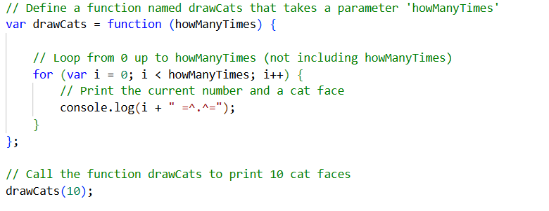
This code starts by Declaring a Variable(drawCats) and Assigns a Function.
This function takes one parameter called howManyTimes, which represents the number of times we want to draw a cat.
The for loop runs the code block as long as i is less than howManyTimes, incrementing i each time.
The console prints the current value of i followed by the string " =^.^="
Lastly calls the drawCats function with the argument 10
NB!! A function helps your computer perform a specific task or operation, like a set of instructions.
Writing some JavaScript (B-p35 & L-p8)

Slide 8
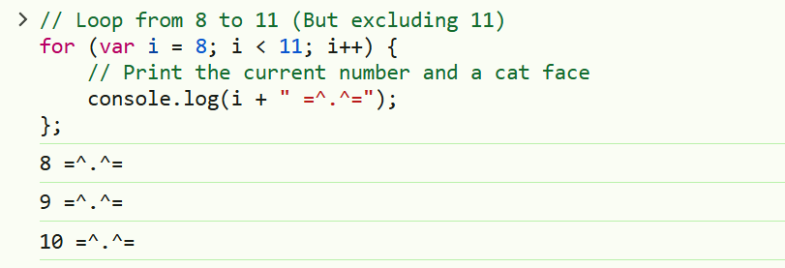
Without a Function:

Slide 9
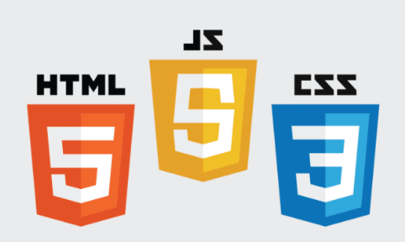
End Of Chapter 1

